Slide 1
CSCIU 310 01 Introduction to Computer Architecture AKM Jahangir A Majumder, PhD
Spring 2019 - Lecture 2
January 16, 2019
Note: Some slides are adapted from those used by previous instructors and some slides include figures from the textbook.

Slide 2
Review and Learning Outcomes
We will review materials covered in CSCI U 210 today
We will begin to cover how a datapath is built to implement MIPS instructions.
Please read the syllabus and sign on the acknowledgement sheet
We will have our first quiz on Monday, January 23 on MIPS assembly language
HW 2 will post on Blackboard soon
No Class on Monday, January 21 Dr. Martin Luther King day

Slide 3
Review on CSCI U210 Syllabus

Slide 4
CPU Time
Performance improved by
Reducing number of clock cycles
Increasing clock rate
Hardware designer must often trade off clock rate against cycle count

Slide 5
Instruction Count and CPI
Instruction Count for a program
Determined by program, ISA and compiler
Average cycles per instruction
Determined by CPU hardware
If different instructions have different CPI
Average CPI affected by instruction mix

Slide 6
Performance Summary
Performance depends on
Algorithm: affects IC, possibly CPI
Programming language: affects IC, CPI
Compiler: affects IC, CPI
Instruction set architecture: affects IC, CPI, T_{c}

Slide 7
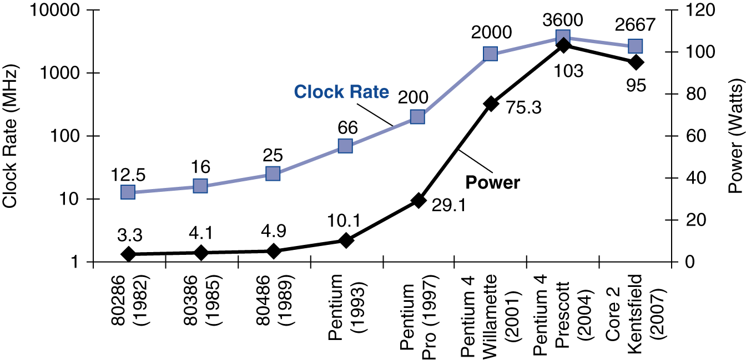
Power Trends
In CMOS IC technology
×30
5V → 1V
×1000

Slide 8
Reducing Power
Suppose a new CPU has
85% of capacitive load of old CPU
15% voltage and 15% frequency reduction
The power wall
We can’t reduce voltage further
We can’t remove more heat
How else can we improve performance?

Slide 9
Different Logic Gates
A
A⋅B
A
(A.B)’
AND
NAND
B
B
A
A+B
A
(A+B)’
OR
NOR
B
B
A
(A+B)
A
A’
NOT
XOR
B
You need to memorize their symbols and functions

Slide 10
Boolean Algebra and Truth Table
Boolean algebra can be used to describe binary logic.
Boolean algebra operators (in the order of priority):
() : Parenthesis
‘ : NOT
⋅ : AND
+ : OR
Truth table can be used to represent input-output relations of a digital system.
You should be able to derive a truth table for a given logic circuit or Boolean algebra presentation and vice versa.

Slide 11
Example: Truth Table, Boolean Algebra, and Digital Logic Circuit
A | B | C | B⋅C | A+B⋅C
0 | 0 | 0 | 0 | 0
0 | 0 | 1 | 0 | 0
0 | 1 | 0 | 0 | 0
0 | 1 | 1 | 1 | 1
1 | 0 | 0 | 0 | 1
1 | 0 | 1 | 0 | 1
1 | 1 | 0 | 0 | 1
1 | 1 | 1 | 1 | 1
A
A+B⋅C
B
C
B⋅C

Slide 12
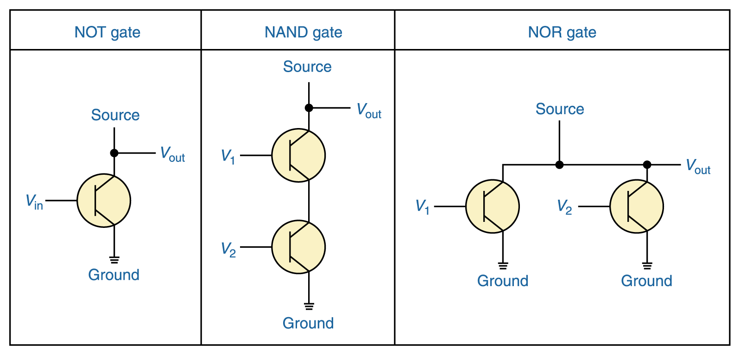
Constructing Gates
It turns out that, because the way a transistor works, the easiest gates to create are the NOT, NAND, and NOR gates

Slide 13
Laws of Boolean Algebra
Identity law
A + 0 = A
A⋅1 = A
Zero and One laws
A + 1 = 1
A ⋅0 = 0
Inverse laws
A + A’ = 1
A⋅ A’ = 0
Commutative laws
A + B = B + A
A . B = B . A
Associative laws
A + (B + C) = (A + B) + C
A . (B . C) = A . (B . C)
Distributive laws
A. (B + C) = (A.B) + (B.C)
A+(B . C) = (A+B) . (A+C)
DeMorgan’s laws
(A⋅B)’=A’+B’
(A+B)’=A’ ⋅B’

Slide 14
Binary Math: Base Conversion
In everyday life, we used decimal base system which uses 10 as base.
In computer systems, binary base and other related bases such as hexadecimal base are used.
Example:
3.25₁₀ =11.01₂
CF.1₁₆=11001111.0001₂
Note: In your exam, any conversion problem answer in format of M/N will receive no credit.

Slide 15
Binary Numbers
Some terminology and units
Bit (b): A single binary digit
Nib: 4 bits
Byte (B): 8-bits
Word: A group of bits of any size (often 4 bytes).
kb: 2¹⁰ bits = 1024 bits (kB = 2¹⁰ bytes)
Mb: 2²⁰ bits =1,048,576 bits (MB = 2²⁰ bytes)
Gb: 2³⁰ bits = 1,073,741,820 bits (GB = 2³⁰ bytes)
MSB: Most significant bit (leftmost digit of binary #)
LSB: Least significant bit (rightmost digit of bin. #)

Slide 16
Binary to Decimal Conversion
Binary Number:
···b₃b₂b₁b₀ (each bit b_{i} is 0 or 1)
Its decimal value is:
b₀×2⁰ + b₁×2¹ + b₂×2² + b₃×2³ + ···
= b₀×1 + b₁×2 + b₂×4 + b₃×8 + ···
Examples: 1110₂ Decimal value is:
1111₂ Decimal value is:
110010₂ Decimal value is:
111111₂ Decimal value is:
14
15
50
63
Check your understanding:
N bits → 2^{N} combinations → decimal numbers 0, 1, 2, 3, …, 2^{N} - 1
The largest number: 11…11₂ = 2^{N}-1 (decimal)
N bits, all ones

Slide 17
Other Conversions
Convert decimal to hex
Use the successive division method described previously (for decimal to binary), but divide by 16 instead of 2.
Convert binary to hex
A hex digit is equivalent to 4 bits.
Divide binary number into groups of 4 bits, starting from the right.
Convert each 4 bit group into one hex digit.
Convert hex to binary
Convert each hex digit to its 4-bit binary equivalent.
String the bits together.
Note: Computationally, it’s easy to convert between bases that are powers of 2, as indicated in the binary to hex conversion technique above.

Slide 18
Other Conversions
Convert decimal to Octal
Use the successive division method described previously (for decimal to binary), but divide by 8 instead of 2.
Convert binary to Octal
A octal digit is equivalent to 3 bits.
Divide binary number into groups of 3 bits, starting from the right.
Convert each 3 bit group into one octal digit.
Convert octal to binary
Convert each octal digit to its 3-bit binary equivalent.
String the bits together.
(examples on next slide)

Slide 19
Fractions
Binary to Decimal Conversion
Binary number: 0.b₋₁b₋₂b₋₃b₋₄···
Decimal value: b₋₁×2⁻¹ + b₋₂×2⁻² + b₋₃×2⁻³ + b₋₄×2⁻⁴ + ···
Example: 0.101₂ = 1×2⁻¹ + 0×2⁻² + 1×2⁻³ = 0.625₁₀
Decimal to Binary Conversion: Successive multiplication by 2
Example: Decimal number 0.6875
0.6875×2 = 1.375 → b₋₁ = 1 and 1.375-1 = 0.375
0.375×2 = 0.75 → b₋₂ = 0 and 0.75-0 = 0.75
0.75×2 = 1.5 → b₋₃=1 and 1.5-1 = 0.5
0.5×2 = 1 → b₋₄=1 and 1-1 = 0
Binary representation: 0.1011

Slide 20
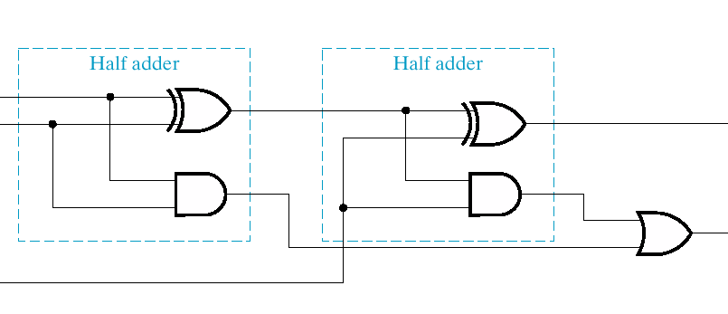
1 Bit Full Adder Implementation
a
sum
b
carry out
carry in
s
=
a
⊕
b
⊕
c_{in}
=
+
⊕
c_{out}
a
b
(
a
b
)
c_{in}

Slide 21
Binary Math: 2’s Complement
In binary world, people use 2’s complement to represent signed integer and implement subtraction.
The procedure of getting 2’s complement of a given number:
Invert every bit
Then add 1
For n bit signed integer, its representation is -2^{n-1} ~ 2^{n-1}-1
Example
11001100₂ = - (00110100)₂ = -52₁₀
10000000₂ = -128₁₀

Slide 22
2’s Complement Adder/Subtractor
Subtraction can be done by addition of the 2's Complement.
1. Complement each bit
2. Add 1 to the result.
The circuit shown computes A + B and A – B:
For S = 1, subtract, the 2’s complement of B is formed by using XORs to form the 1’s comp and adding the 1 applied to C₀.
For S = 0, add, B is passed through unchanged

Slide 23
Binary Math: Overflow Detection
Overflow happens when the calculation result is beyond the representation range for given number of bits.
Overflow might happen in one of following situations:
Positive + Positive
Negative + Negative
Positive – Negative
Negative – Positive
Important: You should determine whether an overflow happen by checking sign bits.
Example:
Overflow: 11000000+10000000=01000000 (the extra carry out bit is discarded)
Overflow: 01000000+01000000=10000000 (no extra bit)
No Overflow 01000000+11000000=00000000 (the extra carry out bit is discarded)

Slide 24
Multiplication and Division by Shifting Bits
We will cover multiplication in great details later. However, some simple multiplication can be accomplished simply by shifting the bit sequence.

Slide 25
Shift Operations
Move (shift) all the bits in a word to the left or right by a number of bits.
Example: shift right by 8 bits
0001 0010 0011 0100 0101 0110 0111 1000
0000 0000 0001 0010 0011 0100 0101 0110
Example: shift left by 8 bits
0001 0010 0011 0100 0101 0110 0111 1000
0011 0100 0101 0110 0111 1000 0000 0000

Slide 26
Shifting and Multiplication
Shift Left a binary number by i bits will give the same result as multiplying by 2^{i}. (True or False)
Shift Right a binary number by i bits will give the same result as dividing by 2^{i}. (True or False)

Slide 27
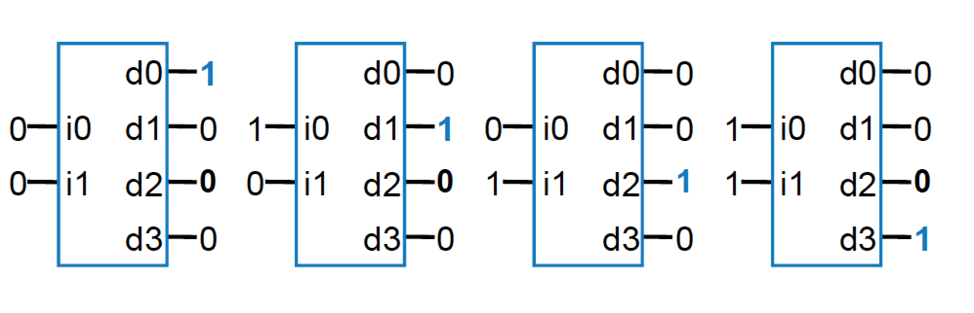
Decoder
Popular combinational logic building block, in addition to logic gates
Collection of logic gates which are arranged in a specific way that converts input binary number to one high output
2-input decoder: four possible input binary numbers... So has four outputs, one for each possible input binary number

Slide 28
Building of 4-to-1-line Multiplexer
2-to-2²-line decoder
2² × 2 AND-OR

Slide 29
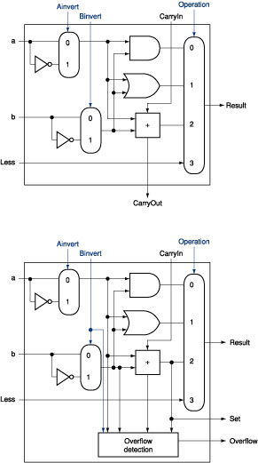
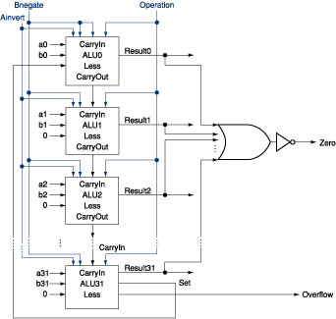
The ALU Diagram
ALU control lines: 0000 = and 0001 = or 0010 = add 0110 = subtract 0111 = slt 1100 = NOR
ALU 0~30
ALU 31
Can this ALU implement a NAND function?

Slide 30
Introduction to Sequential Circuits
Inputs
Outputs
Combina-tional
Logic
A Sequential circuit contains:
Storage elements: Latches or Flip-Flops
Combinatorial Logic:
Implements a multiple-output switching function
Inputs are signals from the outside.
Outputs are signals to the outside.
Other inputs, State or Present State, are signals from storage elements.
The remaining outputs, Next State are inputs to storage elements.
Storage Elements
Next
State
State

Slide 31
The Latch Timing Problem (continued)
Consider the following circuit:
Suppose that initially Y = 0.
As long as C = 1, the value of Y continues to change!
The changes are based on the delay present on the loop through the connection from Y back to Y.
This behavior is clearly unacceptable.
Desired behavior: Y changes only once per clock pulse
Y
D
Q
Clock
C
Q
Clock
Y

Slide 32
Storage Element’s Timing Model
Clk
Setup
Hold
D
Q
D
Don’t Care
Don’t Care
Clock-to-Q
Q
Unknown
Setup Time: Input must be stable BEFORE trigger clock edge
Hold Time: Input must REMAIN stable after trigger clock edge
Clock-to-Q time:
Output cannot change instantaneously at the trigger clock edge
Similar to delay in logic gates, two components:
Internal Clock-to-Q
Load dependent Clock-to-Q
Typical for class: 1ns Setup, 0.5ns Hold
Notes:
So far we have been looking at combinational logic, let’s look at the timing characteristic of a storage element.
The storage element you will use is a D type flip-flop trigger on the negative clock edge.
In order for the data to latch into the flip flop correctly, the input must be stable slightly before the falling edge of the clock. This time is called the Setup time.
After the clock edge has arrived, the data must remain stable for a short amount of time AFTER the trigger clock edge. This is called the hold time.
The output cannot change instantaneously at the trigger clock edge. The time it takes for the output to change to its new value after the clock is called the Clock-to-Q time.
Similar to delay in logic gates, the Clock-to-Q time has two components:
(a) The internal Clock-to-Q time: the time it takes the output to change if output load is zero.
(b) And the load dependent Clock-to-Q time.
+2 = 50 min. (Y:30)

Slide 33
Machine Format
Our processor’s machine code format is given below
[load, regad1, regad2, des_regad, aluop]
load signal: 1 (read from external input), 0 (read from ALU)
regad1: the address of the register for the ALU input 1
regad2: the address of the register for the ALU input 2
des_regad: the address of the destination register which data is written into
aluop: the ALU function selection
There are 16 registers and 8 ALU functions.
Question: Based on the above description of the processor, how many bits each command should have?

Slide 34
MIPS Assembly Language
We’ll be working with the MIPS instruction set architecture
developed in 1985
means “Microprocessor without Interlocked Pipeline Stages”
similar to other architectures developed since the 1980's
almost 100 million MIPS processors manufactured in 2002
used by NEC, Nintendo, Cisco, Silicon Graphics, Sony, …
a Reduced Instruction Set Computer (RISC) Assembly Language
Instruction Category:
Arithmetic: Add, Subtract,…
Data Transfer: Load Word,…
Logical: And, Or,…
Conditional Branch: Branch on Equal,…
Unconditional Jump: Jump

Slide 35
MIPS Computer Simulator: SPIM
SPIM is a simulator developed for MIPS computer simulation.
You can download SPIM simulator PCSpim http://www.cs.wisc.edu/~larus/spim.html

Slide 36
Assembly Variables: Registers Cont..
Registers are numbered from 0 to 31
Each register can be referred to by number or name
Number references:
$0, $1, $2, … $30, $31

Slide 37
Assembly Variables: Registers Cont…
By convention, each register also has a name to make it easier to code
For now:
$16 - $23 ➔ $s0 - $s7
(correspond to C variables)
$8 - $15 ➔ $t0 - $t7
(correspond to temporary variables)
In general, use names to make your code more readable

Slide 38
C, Java variables vs. registers
In C (and most High Level Languages) variables declared first and given a type
Example: int fahr, celsius; char a, b, c, d, e;
Each variable can ONLY represent a value of the type it was declared as (cannot mix and match int and char variables).
In Assembly Language, the registers have no type; operation determines how register contents are treated

Slide 39
MIPS Registers
USE Number Name
The constant 0 $0 $zero
Reserved for Assembler $1 $at
Return Values $2-$3 $v0-$v1
Arguments $4-$7 $a0-$a3
Temporary $8-$15 $t0-$t7
Saved Temporaries $16-$23 $s0-$s7
Temporary $24-$25 $t8-$t9
Used by Kernel $26-$27 $k0-$k1
Global Pointer $28 $gp
Stack Pointer $29 $sp
Frame Pointer $30 $fp
Return Address $31 $ra

Slide 40
Registers vs. Memory
Arithmetic instructions operands must be registers, — only 32 registers provided
Which computer components do registers belongs to?
Compiler associates variables with registers
What about programs with lots of variables?
Control
Input
Memory
Datapath
Output
Processor
I/O

Slide 41
Comments in MIPS Programs
You can use comments to make your code more readable.
Hash (#) is used for MIPS comments
anything from hash mark to end of line is a comment and will be ignored
Note: Different from C.
C comments have format /* comment */ so they can span many lines

Slide 42
MIPS Addition and Subtraction (1/4)
Syntax of Instructions:
1 2, 3, 4
where:
1) operation by name
2) operand getting result (“destination”)
3) 1st operand for operation (“source1”)
4) 2nd operand for operation (“source2”)
Syntax is rigid:
1 operator, 3 operands
Operand order is fixed (destination first)
Why? Keep Hardware simple via regularity
Design Principle: simplicity favors regularity.

Slide 43
Addition and Subtraction of Integers (2/4)
Addition in Assembly
Example: add $s0,$s1,$s2 (in MIPS)
Equivalent to: a = b + c (in C)
where MIPS registers $s0,$s1,$s2 are associated with C variables a, b, c
Subtraction in Assembly
Example: sub $s3,$s4,$s5 (in MIPS)
Equivalent to: d = e - f (in C)
where MIPS registers $s3,$s4,$s5 are associated with C variables d, e, f

Slide 44
Addition and Subtraction of Integers (3/4)
How do the following C statement?
a = b + c + d - e;
Break into multiple instructions
add $t0, $s1, $s2 # temp = b + c
add $t0, $t0, $s3 # temp = temp + d
sub $s0, $t0, $s4 # a = temp - e
Notice: A single line of C may break up into several lines of MIPS.
Notice: Everything after the hash mark on each line is ignored (comments)

Slide 45
Addition and Subtraction of Integers (4/4)
How do we do this?
f = (g + h) - (i + j);
Use intermediate temporary register
add $t0,$s1,$s2 # temp = g + h
add $t1,$s3,$s4 # temp = i + j
sub $s0,$t0,$t1 # f=(g+h)-(i+j)

Slide 46
Immediates
Immediates are numerical constants.
They appear often in code, so there are special instructions for them.
Add Immediate:
addi $s0,$s1,10 (in MIPS)
f = g + 10 (in C)
where MIPS registers $s0,$s1 are associated with C variables f, g
Syntax similar to add instruction, except that last argument is a number instead of a register.

Slide 47
Immediates
There is no Subtract Immediate in MIPS:
Limit types of operations that can be done to absolute minimum
if an operation can be decomposed into a simpler operation, don’t include it
addi …, -X = subi …, X => so no subi
addi $s0,$s1,-10 (in MIPS)
f = g - 10 (in C)
where MIPS registers $s0,$s1 are associated with C variables f, g

Slide 48
Register Zero
One particular immediate, the number zero (0), appears very often in code.
So we define register zero ($0 or $zero) to always have the value 0; eg
add $s0,$s1,$zero (in MIPS)
f = g (in C)
where MIPS registers $s0,$s1 are associated with C variables f, g
defined in hardware, so an instruction
add $zero,$zero,$s0
will not do anything!

Slide 49
Review: MIPS Instruction Format
3 Instruction Formats: all 32 bits wide
OP
rs
rt
rd
sa
funct
OP
rs
rt
immediate
OP
jump target

Slide 50
Machine Language: R-Type
Numeric version of instructions is called machine language
Instructions, like registers and words of data, are also 32 bits long
Example: add $t0, $s1, $s2
registers have numbers, $t0=8, $s1=17, $s2=18
Instruction Format: add $t0, $s1, $s2
000000 10001 10010 01000 00000 100000 op rs rt rd shamt funct
Can you guess what the field names stand for?
Notes:
Board work: Binary Numbers

Slide 51
Machine Language: I-Type
Consider the addi instructions,
What would the regularity principle have us do?
New principle: Good design demands a compromise
Introduce a new type of instruction format
I-type for immediates
other format was R-type for register
Example: addi $s1, $s2, 100 8 18 17 100 op rs rt 16 bit number

Slide 52
MIPS Fields
op: Basic operation of the instruction, opcode
rs: The first register source operand
rt: The second register source operand
rd: The register destination operand.
shamt: Shift amount
funct: Function

Slide 53
Assembly Operands: Memory
C variables map onto registers; what about large data structures like arrays?
1 of 5 components of a computer: memory contains such data structures
But MIPS arithmetic instructions only operate on registers, never directly on memory.
Data transfer instructions transfer data between registers and memory:
Memory to register
Register to memory

Slide 54
Anatomy: 5 components of any Computer
Registers are in the datapath of the processor; if operands are in memory, we must transfer them to the processor to operate on them, and then transfer back to memory when done.
Personal Computer
Computer
Processor
Memory
Devices
Control
(“brain”)
Input
Store (to)
Datapath
Registers
Load (from)
Output
These are “data transfer” instructions…
Notes:
That is, any computer, no matter how primitive or advance, can be divided into five parts:
1. The input devices bring the data from the outside world into the computer.
2. These data are kept in the computer’s memory until ...
3. The datapath request and process them.
4. The operation of the datapath is controlled by the computer’s controller.
All the work done by the computer will NOT do us any good unless we can get the data back to the outside world.
5. Getting the data back to the outside world is the job of the output devices.
The most COMMON way to connect these 5 components together is to use a network of busses.

Slide 55
Data Transfer: Memory to Reg (1/4)
To transfer a word of data, we need to specify two things:
Register: specify this by # ($0 - $31) or symbolic name ($s0,…, $t0, …)
Memory address: more difficult
Think of memory as a single one-dimensional array, so we can address it simply by supplying a pointer to a memory address.
Other times, we want to be able to offset from this pointer.
Remember: “Load FROM memory”

Slide 56
Data Transfer: Memory to Reg (2/4)
To specify a memory address to copy from, specify two things:
A register containing a pointer to memory
A numerical offset (in bytes)
The desired memory address is the sum of these two values.
Example: 8($t0)
specifies the memory address pointed to by the value in $t0, plus 8 bytes

Slide 57
Data Transfer: Memory to Reg (3/4)
Load Instruction Syntax:
1 2, 3(4)
where
1) operation name
2) register that will receive value
3) numerical offset in bytes
4) register containing pointer to memory
MIPS Instruction Name:
lw (meaning Load Word, so 32 bits or one word are loaded at a time)

Slide 58
Data Transfer: Memory to Reg (4/4)
Data flow
Example: lw $t0,12($s0)
This instruction will take the pointer in $s0, add 12 bytes to it, and then load the value from the memory pointed to by this calculated sum into register $t0
Notes:
$s0 is called the base register
12 is called the offset
offset is generally used in accessing elements of array or structure: base reg points to beginning of array or structure

Slide 59
Data Transfer: Reg to Memory
Also want to store from register into memory
Store instruction syntax is identical to Load’s
MIPS Instruction Name:
sw (meaning Store Word, so 32 bits or one word are loaded at a time)
Example: sw $t0,12($s0)
This instruction will take the pointer in $s0, add 12 bytes to it, and then store the value from register $t0 into that memory address
Remember: “Store INTO memory”
Data flow

Slide 60
System Calls
SPIM provides a small set of operating-system-like services through the system call (syscall) instruction.
To request a service, a program load the system call code into the register $v0 and arguments into registers $a0-$a3.

Slide 61
Pseudoinstruction
The following two instructions are not real MIPS instruction. They can be implemented with real MIPS instruction though. Therefore, they are called “pseudoinstructions.” They are created for the convenience of programmers.
li $reg, imm (load immediate)
- $reg=imm
la $reg address (load address)
- $reg=address
To use pseudoinstructions, you need to specify that pseudoinstrcutions is allowed in the setting of SPIM simulator.

Slide 62
Assembler Directives
Assembler directives begin a period.
Assembler directives tell the assembler how to translate a program but do not produce machine code for itself.
Example:
.globl sym: declare that label sym is global and can be referred from other files.
.text: subsequent items are put in the user segment. In SPIM, these items may only be instructions or words.
.data: declare that subsequent items are stored in the data segment.
.asciiz str: store the string str in memory and null-terminated

Slide 63
The First Program: Hello World
.text
.globl main
main:
li $v0, 4
la $a0, str
syscall # print string
li $v0, 10
syscall # exit (you must use syscall #10 to exit)
.data
str: .asciiz "Hello World!!!"

Slide 64
MIPS Data Transfer Instructions Example
Word Address
C code: A[12] = h + A[8]; MIPS code: lw $t0, 32($s3) # load word add $t0, $s2, $t0 sw $t0, 48($s3) # store word
$s3: base address (as called index register)
Can refer to registers by name (e.g., $s2, $t2) instead of number
Store word has destination last
Remember arithmetic operands are registers, not memory! Can’t write: add 48($s3), $s2, 32($s3)
Byte Address

Slide 65
Pointers v. Values
Key Concept: A register can hold any 32-bit value. That value can be a (signed) int, an unsigned int, a pointer (memory address), and so on
If you write add $t2,$t1,$t0 then $t0 and $t1 better contain values
If you write lw $t2,0($t0) then $t0 better contain a pointer
Don’t mix these up!

Slide 66
Addressing: Byte vs. Word
Every word in memory has an address, similar to an index in an array
Early computers numbered words like C numbers elements of an array:
Memory[0], Memory[1], Memory[2], …
Called the “address” of a word
Computers needed to access 8-bit bytes as well as words (4 bytes/word)
Today machines address memory as bytes, (i.e.,“Byte Addressed”) hence 32-bit (4 byte) word addresses differ by 4
Memory[0], Memory[4], Memory[8], …

Slide 67
Compilation with Memory
What offset in lw to select A[5] in C?
4x5=20 to select A[5]: byte v. word
Compile by hand using registers: g = h + A[5];
g: $s1, h: $s2, $s3:base address of A
1st transfer from memory to register:
lw $t0,20($s3) # $t0 gets A[5]
Add 20 to $s3 to select A[5], put into $t0
Next add it to h and place in g add $s1,$s2,$t0 # $s1 = h+A[5]

Slide 68
Notes about Memory
Pitfall: Forgetting that sequential word addresses in machines with byte addressing do not differ by 1.
Many an assembly language programmer has toiled over errors made by assuming that the address of the next word can be found by incrementing the address in a register by 1 instead of by the word size in bytes.
So remember that for both lw and sw, the sum of the base address and the offset must be a multiple of 4 (to be word aligned)

Slide 69
More Notes about Memory: Alignment
MIPS requires that all words start at byte addresses that are multiples of 4 bytes
Last hex digit of address is:
0 1 2 3
Aligned
0, 4, 8, or C_{hex}
1, 5, 9, or D_{hex}
Not
Aligned
2, 6, A, or E_{hex}
3, 7, B, or F_{hex}
Called Alignment: objects must fall on address that is multiple of their size.

Slide 70
MIPS Control Instruction I: Conditional Branch
Decision making instructions
alter the control flow,
i.e., change the "next" instruction to be executed
MIPS conditional branch instructions:
bne $t0, $t1, Label : if ($t0!=$t1) go to Label beq $t0, $t1, Label : if ($t0==$t1) go to Label
Example: if (i==j) h = i + j; bne $s0, $s1, Label add $s3, $s0, $s1 Label: ....

Slide 71
MIPS Control Instruction II: Unconditional Jump
MIPS unconditional branch instructions: j label
Example: if (i!=j) beq $s4, $s5, Lab1 h=i+j; add $s3, $s4, $s5 else j Lab2 h=i-j; Lab1: sub $s3, $s4, $s5 Lab2: ...
Technically, it’s the same as:
beq $0,$0,label
since it always satisfies the condition.

Slide 72
Example: Compiling C if into MIPS (1/2)
Compile by hand
if (i == j) f=g+h; else f=g-h;
Use this mapping: f: $s0 g: $s1 h: $s2 i: $s3 j: $s4
(true) i == j
(false) i != j
i == j?
f=g+h
f=g-h
Exit

Slide 73
Example: Compiling C if into MIPS (2/2)
Compile by hand
if (i == j) f=g+h; else f=g-h;
(true) i == j
(false) i != j
i == j?
f=g+h
f=g-h
Final compiled MIPS code:
beq $s3,$s4,True # branch i==j sub $s0,$s1,$s2 # f=g-h(false) j Fin # goto Fin True: add $s0,$s1,$s2 # f=g+h (true) Fin:
Note: Compiler automatically creates labels to handle decisions (branches). Generally not found in HLL code.
Exit

Slide 74
Inequalities in MIPS (1/5)
Until now, we’ve only tested equalities (== and != in C). General programs need to test < and > as well.
Create a MIPS Inequality Instruction:
“Set on Less Than”
Syntax: slt reg1,reg2,reg3
Meaning: reg1 = (reg2 < reg3);
if (reg2 < reg3) reg1 = 1; else reg1 = 0;
Usually, “set” means “set to 1”, “reset” means “set to 0”.
Same thing…

Slide 75
Inequalities in MIPS (2/5)
How do we use this? Compile by hand: if (g < h) goto Less; #g:$s0, h:$s1
Answer: compiled MIPS code…
slt $t0,$s0,$s1 # $t0 = 1 if g<h bne $t0,$0,Less # goto Less # if $t0!=0 # (if (g<h)) Less:
Branch if $t0 != 0 ➔ (g < h)
Register $0 always contains the value 0, so bne and beq often use it for comparison after an slt instruction.
A slt ➔ bne pair means if(… < …)goto…

Slide 76
Inequalities in MIPS (3/5)
We covered two pseudo instructions, li and la, in our SPIM tutorial session.
The following pseudo instruction is also useful:
"blt $s1, $s2, Label“
called “branch on less than”
can now build general control structures
Note that the assembler needs a register ($at: assembler temporary) to do this,
there are policy of use conventions for registers
Notes:
Board work: Binary Numbers

Slide 77
Inequalities in MIPS (4/5)
Now, we can implement <, but how do we implement >, ≤ and ≥ ?
We could add 3 more instructions, but:
MIPS goal: Simpler is Better
Can we implement ≤ in one or more instructions using just slt and the branches?
What about >?
What about ≥?

Slide 78
Inequalities in MIPS (5/5)
if (g >= h) goto Loop #g:$s0, h:$s1
Loop: . . .
slt $t0,$s0,$s1 # $t0 = 1 if # $s0<$s1 (g<h) beq $t0,$0,Loop # goto Loop # if $t0==0 # if (g ≥ h))
C
M I P S
A slt ➔ beq pair means if(… ≥ …)goto…

Slide 79
Example: The C Switch Statement (1/3)
Choose among four alternatives depending on whether k has the value 0, 1, 2 or 3. Compile this C code: switch (k) { case 0: f=i+j; break; /* k=0 */ case 1: f=g+h; break; /* k=1 */ case 2: f=g–h; break; /* k=2 */ case 3: f=i–j; break; /* k=3 */ }

Slide 80
Example: The C Switch Statement (2/3)
This is complicated, so simplify.
Rewrite it as a chain of if-else statements, which we already know how to compile:
if(k==0) f=i+j; else if(k==1) f=g+h; else if(k==2) f=g–h; else if(k==3) f=i–j;
Use this mapping:
f:$s0, g:$s1, h:$s2, i:$s3, j:$s4, k:$s5

Slide 81
Example: The C Switch Statement (3/3)
Final compiled MIPS code: bne $s5,$0,L1 # branch k!=0 add $s0,$s3,$s4 #k==0 so f=i+j j Exit # end of case so Exit L1: addi $t0,$s5,-1 # $t0=k-1 bne $t0,$0,L2 # branch k!=1 add $s0,$s1,$s2 #k==1 so f=g+h j Exit # end of case so Exit L2: addi $t0,$s5,-2 # $t0=k-2 bne $t0,$0,L3 # branch k!=2 sub $s0,$s1,$s2 #k==2 so f=g-h j Exit # end of case so Exit L3: addi $t0,$s5,-3 # $t0=k-3 bne $t0,$0,Exit # branch k!=3 sub $s0,$s3,$s4 #k==3 so f=i-j Exit:

Slide 82
MIPS Control Instructions Syntax
Instruction Meaning bne $s4,$s5,L Next instr. is at Label if $s4 ≠ $s5 beq $s4,$s5,L Next instr. is at Label if $s4 = $s5 j Label Next instr. is at Label slt $s1,$s2,$s3 if ($s2<$s3) $s1=1; else $s1=0
Formats:
op rs rt rd shamt funct
R
I
J
op rs rt 16 bit address
op 26 bit address

Slide 83
MIPS Logical Operations
Three basic logical operators in MIPS:
AND: outputs 1 only if both inputs are 1
OR: outputs 1 if at least one input is 1
NOR: outputs 1 if both inputs are 0
Truth Table: standard table listing all possible combinations of inputs and resultant output for each. E.g.,
A | B | A AND B | A OR B | A NOR B
0 | 0 | 0 | 0 | 1
0 | 1 | 0 | 1 | 0
1 | 0 | 0 | 1 | 0
1 | 1 | 1 | 1 | 0

Slide 84
Logical Instruction Syntax
R-Format
op rs rt rd shamt funct
I-Format
op rs rt 16 bit number
$s1 = $s2&$s3: and $s1, $s2, $s3
$s1 = $s2|$3: or $s1, $s2, $s3
$s1 = ~($s2|$s3): nor $s1, $s2, $s3
There is another important logical function, NOT.
NOT (1) = 0 and NOT (0) = 1.
How to implement NOT function (~) with MIPS instruction?

Slide 85
Exercise: Implement NOT function with NOR instruction
A NOR 0 = NOT (A)
Nor $s1, $s2, $zero : $s1=~$s2

Slide 86
Shift Operations
Move (shift) all the bits in a word to the left or right by a number of bits.
Example: shift right by 8 bits
0001 0010 0011 0100 0101 0110 0111 1000
0000 0000 0001 0010 0011 0100 0101 0110
Example: shift left by 8 bits
0001 0010 0011 0100 0101 0110 0111 1000
0011 0100 0101 0110 0111 1000 0000 0000
What arithmetic effect does shift left have?

Slide 87
Shift Instruction Syntax
MIPS shift instructions:
1. sll (shift left logical): shifts left and fills emptied bits with 0s
2. srl (shift right logical): shifts right and fills emptied bits with 0s
Machine version of “sll $t2, $s0, 4”:
op rs rt rd shamt funct
0 0 16 10 4 0

Slide 88
Loops in C/Assembly (1/3)
Simple loop in C; A[] is an array of integers
do {g = g + A[i];
i = i + j; } while (i != h);
Rewrite this as:
Loop: g = g + A[i]; i = i + j; if (i != h) goto Loop;
Use this mapping: g, h, i, j, base of A $s1, $s2, $s3, $s4, $s5

Slide 89
Loops in C/Assembly (2/3)
Final compiled MIPS code:
Loop: sll $t1,$s3,2 #$t1= 4*i add $t1,$t1,$s5 #$t1=addr A lw $t1,0($t1) #$t1=A[i] add $s1,$s1,$t1 #g=g+A[i] add $s3,$s3,$s4 #i=i+j bne $s3,$s2,Loop# goto Loop # if i!=h
Original code:
Loop: g = g + A[i]; i = i + j; if (i != h) goto Loop;
Use this mapping: g, h, i, j, base of A $s1, $s2, $s3, $s4, $s5
Notes:
Do goto first
Then I = I + J
Then 1st 4

Slide 90
Example: The C Switch Statement (2/3)
This is complicated, so simplify.
Rewrite it as a chain of if-else statements, which we already know how to compile:
if(k==0) f=i+j; else if(k==1) f=g+h; else if(k==2) f=g–h; else if(k==3) f=i–j;
Use this mapping:
f:$s0, g:$s1, h:$s2, i:$s3, j:$s4, k:$s5

Slide 91
Example: The C Switch Statement (3/3)
Final compiled MIPS code: bne $s5,$0,L1 # branch k!=0 add $s0,$s3,$s4 #k==0 so f=i+j j Exit # end of case so Exit L1: addi $t0,$s5,-1 # $t0=k-1 bne $t0,$0,L2 # branch k!=1 add $s0,$s1,$s2 #k==1 so f=g+h j Exit # end of case so Exit L2: addi $t0,$s5,-2 # $t0=k-2 bne $t0,$0,L3 # branch k!=2 sub $s0,$s1,$s2 #k==2 so f=g-h j Exit # end of case so Exit L3: addi $t0,$s5,-3 # $t0=k-3 bne $t0,$0,Exit # branch k!=3 sub $s0,$s3,$s4 #k==3 so f=i-j Exit:

Slide 92
MIPS Control Instructions Syntax
Instruction Meaning bne $s4,$s5,L Next instr. is at Label if $s4 ≠ $s5 beq $s4,$s5,L Next instr. is at Label if $s4 = $s5 j Label Next instr. is at Label slt $s1,$s2,$s3 if ($s2<$s3) $s1=1; else $s1=0
Formats:
op rs rt rd shamt funct
R
I
J
op rs rt 16 bit address
op 26 bit address

Slide 93
MIPS R3000 Instruction Set Architecture (Summary)
Instruction Categories
Load/Store
Computational
Jump and Branch
Floating Point
coprocessor
Memory Management
Special
Registers
R0 - R31
PC
HI
LO
3 Instruction Formats: all 32 bits wide
OP
rs
rt
rd
sa
funct
OP
rs
rt
immediate
OP
jump target

Slide 94
Review: MIPS Fields
op: Basic operation of the instruction, opcode
rs: The first register source operand
rt: The second register source operand
rd: The register destination operand.
shamt: Shift amount
funct: Function

Slide 95
MIPS Logical Operations
Three basic logical operators in MIPS:
AND: outputs 1 only if both inputs are 1
OR: outputs 1 if at least one input is 1
NOR: outputs 1 if both inputs are 0
Truth Table: standard table listing all possible combinations of inputs and resultant output for each. E.g.,
A | B | A AND B | A OR B | A NOR B
0 | 0 | 0 | 0 | 1
0 | 1 | 0 | 1 | 0
1 | 0 | 0 | 1 | 0
1 | 1 | 1 | 1 | 0

Slide 96
Logical Instruction Syntax
R-Format
op rs rt rd shamt funct
I-Format
op rs rt 16 bit number
$s1 = $s2&$s3: and $s1, $s2, $s3
$s1 = $s2|$3: or $s1, $s2, $s3
$s1 = ~($s2|$s3): nor $s1, $s2, $s3
There is another important logical function, NOT.
NOT (1) = 0 and NOT (0) = 1.
How to implement NOT function (~) with MIPS instruction?

Slide 97
Exercise: Implement NOT function with NOR instruction
A NOR 0 = NOT (A)
Nor $s1, $s2, $zero : $s1=~$s2

Slide 98
Exercise
$s2: 1011 0110 1010 0100 0011 1101 1001 1010
$s3: 0000 0000 0000 0000 0000 1111 0000 0000
and $s1, $s2, $s3
$s1=?

Slide 99
Shift Operations
Move (shift) all the bits in a word to the left or right by a number of bits.
Example: shift right by 8 bits
0001 0010 0011 0100 0101 0110 0111 1000
0000 0000 0001 0010 0011 0100 0101 0110
Example: shift left by 8 bits
0001 0010 0011 0100 0101 0110 0111 1000
0011 0100 0101 0110 0111 1000 0000 0000
What arithmetic effect does shift left have?

Slide 100
Shift Instruction Syntax
MIPS shift instructions:
1. sll (shift left logical): shifts left and fills emptied bits with 0s
2. srl (shift right logical): shifts right and fills emptied bits with 0s
Machine version of “sll $t2, $s0, 4”:
op rs rt rd shamt funct
0 0 16 10 4 0

Slide 101
Exercise: Shift Operations
Let $S0= 0001 0010 0011 0100 0101 0110 0111 1000
sll $t2, $s0, 4
$t2 = ?
srl $t2, $s0, 8
$t2 = ?

Slide 102
Loops in C/Assembly (1/3)
Simple loop in C; A[] is an array of integers
do {g = g + A[i];
i = i + j; } while (i != h);
We can rewrite this as:
Loop: g = g + A[i]; i = i + j; if (i != h) goto Loop;
Use this mapping: g, h, i, j, base of A $s1, $s2, $s3, $s4, $s5

Slide 103
Loops in C/Assembly (2/3)
Final compiled MIPS code:
Loop: sll $t1,$s3,2 #$t1= 4*i add $t1,$t1,$s5 #$t1=addr A lw $t1,0($t1) #$t1=A[i] add $s1,$s1,$t1 #g=g+A[i] add $s3,$s3,$s4 #i=i+j bne $s3,$s2,Loop# goto Loop # if i!=h
Original code:
Loop: g = g + A[i]; i = i + j; if (i != h) goto Loop;
Use this mapping: g, h, i, j, base of A $s1, $s2, $s3, $s4, $s5
Notes:
Do goto first
Then I = I + J
Then 1st 4

Slide 104
Loops in C/Assembly (3/3)
There are three types of loops in C:
while
do… while
for
Each can be rewritten as either of the other two, so the method used in the previous example can be applied to while and for loops as well.
Key Concept: Though there are multiple ways of writing a loop in MIPS, the key to decision making is conditional branch

Slide 105
Partial SPIM System Service List
print_int $a0=integer
print_float $f12=float
print_double $f12=double
print_string $a0=string
read_int put integer in $v0
read_float put float number in $fo
read_double put double in $fo
read_string $a0=buffer, $a1=length
sbrk address in $vo
exit

Slide 106
Constants
Small constants are used quite frequently (50% of operands) e.g., A = A + 5; B = B + 1; C = C - 18;
Solutions? Why not?
put 'typical constants' in memory and load them.
create hard-wired registers (like $zero) for constants like one.
MIPS Instructions: addi $29, $29, 4 slti $8, $18, 10 andi $29, $29, 6 ori $29, $29, 4
Design Principle: Make the common case fast. Which format?

Slide 107
How about larger constants?
We'd like to be able to load a 32 bit constant into a register
Must use two instructions, new "load upper immediate" instruction lui $t0, 1010101010101010
Then must get the lower order bits right, i.e., ori $t0, $t0, 1010101010101010
filled with zeros
1010101010101010
0000000000000000
1010101010101010
0000000000000000
0000000000000000
1010101010101010
ori
1010101010101010
1010101010101010

Slide 108
Overflow in Arithmetic (1/2)
Reminder: Overflow occurs when there is a mistake in arithmetic due to the limited precision in computers.
Example (4-bit unsigned numbers):
+15 1111
+3 0011
+18 10010
But we don’t have room for 5-bit solution, so the solution would be 0010, which is +2, and wrong.

Slide 109
Overflow in Arithmetic (2/2)
Some languages detect overflow (Ada), some don’t (C)
MIPS solution is 2 kinds of arithmetic instructions to recognize 2 choices:
add (add), add immediate (addi) and subtract (sub) cause overflow to be detected
add unsigned (addu), add immediate unsigned (addiu) and subtract unsigned (subu) do not cause overflow detection
Compiler selects appropriate arithmetic
MIPS C compilers produce addu, addiu, subu

Slide 110
Immediates in Inequalities
There is also an immediate version of slt to test against constants: slti
Helpful in for loops
if (g >= 1) goto Loop
Loop: . . . slti $t0,$s0,1 # $t0 = 1 if # $s0<1 (g<1) beq $t0,$0,Loop # goto Loop # if $t0==0 # (if (g>=1))
C
M I P S
A slt ➔ beq pair means if(… ≥ …)goto…

Slide 111
What about unsigned numbers?
Also unsigned inequality instructions:
sltu, sltiu
…which sets result to 1 or 0 depending on unsigned comparisons
What is value of $t0, $t1?
($s0 = FFFF FFFA_{hex}, $s1 = 0000 FFFA_{hex})
slt $t0, $s0, $s1
sltu $t1, $s0, $s1

Slide 112
Loading, Storing bytes (1/2)
In addition to word data transfers (lw, sw), MIPS has byte data transfers:
load byte: lb: load a byte from the memory, placing it in the rightmost 8 bits of a register.
store byte: sb: take a byte from the rightmost 8 bits of a register and write it to the memory.
same format as lw, sw

Slide 113
Loading, Storing bytes (2/2)
What do with other 24 bits in the 32 bit register?
lb: sign extends to fill upper 24 bits
xxxx xxxx xxxx xxxx xxxx xxxx
zzz zzzz
x
byte loaded
…is copied to “sign-extend”
This bit
Normally don't want to sign extend chars
MIPS instruction that doesn’t sign extend when loading bytes:
load byte unsigned: lbu

Slide 114
MIPS Signed vs. Unsigned – different meanings!
MIPS Signed v. Unsigned is an “overloaded” term
Do/Don't sign extend (lb, lbu)
Don't overflow (addu, addiu, subu, multu, divu)
Do signed/unsigned compare (slt, slti/sltu, sltiu)

Slide 115
Procedure in C functions
What information must compiler/programmer keep track of?
main() { int i,j,k,m; ... i = mult(j,k); ... m = mult(i,i); ...
}
/* really dumb mult function */
int mult (int mcand, int mlier){ int product;
product = 0; while (mlier > 0) { product = product + mcand; mlier = mlier -1; } return product; }
What instructions can
accomplish this?

Slide 116
Function Call Bookkeeping
Registers play a major role in keeping track of information for function calls.
Register conventions:
Return address $ra
Arguments $a0, $a1, $a2, $a3
Return value $v0, $v1
Local variables $s0, $s1, … , $s7
The stack is also used; more later.

Slide 117
Instruction Support for Functions (1/6)
... sum(a,b);... /* a,b:$s0,$s1 */ } int sum(int x, int y) { return x+y; }
address 1000 1004 1008 1012 1016
2000 2004
C
In MIPS, all instructions are 4 bytes, and stored in memory just like data. So here we show the addresses of where the programs are stored.
M I P S

Slide 118
Instruction Support for Functions (2/6)
... sum(a,b);... /* a,b:$s0,$s1 */ } int sum(int x, int y) { return x+y; }
address 1000 add $a0,$s0,$zero # x = a 1004 add $a1,$s1,$zero # y = b 1008 addi $ra,$zero,1016 #$ra=1016 1012 j sum #jump to sum 1016 ...
2000 sum: add $v0,$a0,$a1 2004 jr $ra # new instruction
C
M I P S

Slide 119
Instruction Support for Functions (3/6)
... sum(a,b);... /* a,b:$s0,$s1 */ } int sum(int x, int y) { return x+y; }
2000 sum: add $v0,$a0,$a1 2004 jr $ra # new instruction
C
M I P S
Question: Why use jr here? Why not simply use j?
Answer: sum might be called by many functions, so we can’t return to a fixed place. The calling proc to sum must be able to say “return here” somehow.

Slide 120
Instruction Support for Functions (4/6)
Single instruction to jump and save return address: jump and link (jal)
Before: 1008 addi $ra,$zero,1016 #$ra=1016 1012 j sum #goto sum
After: 1008 jal sum # $ra=1012,goto sum
Why have a jal? Make the common case fast: function calls are very common. Also, you don’t have to know where the code is loaded into memory with jal.

Slide 121
Instruction Support for Functions (5/6)
Syntax for jal (jump and link) is same as for j (jump):
jal label
jal should really be called laj for “link and jump”:
Step 1 (link): Save address of next instruction into $ra (Why next instruction? Why not current one?) – infinite loop
Step 2 (jump): Jump to the given label

Slide 122
Instruction Support for Functions (6/6)
Syntax for jr (jump register):
jr register
Instead of providing a label to jump to, the jr instruction provides a register which contains an address to jump to.
Only useful if we know exact address to jump to.
Very useful for function calls:
jal stores return address in register ($ra)
jr $ra jumps back to that address

Slide 123
Stored Program Concept
Instructions are bits
Programs are stored in memory — to be read or written just like data
Fetch & Execute Cycle
Instructions are fetched and put into a special register
Bits in the register "control" the subsequent actions
Fetch the “next” instruction and continue
memory for data, programs,
compilers, editors, etc.
Processor
Memory

Slide 124
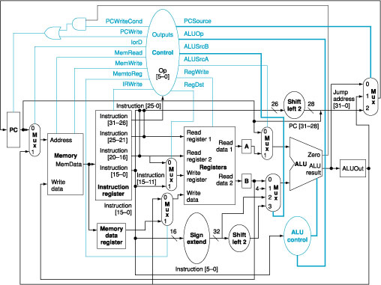
A MIPS Computer Architecture

Slide 125
MIPS Register and Instructions to Implement Procedure
Register Name Meaning
PC Program Counter (hold the address of the current instruction)
$ra return address
Instruction Name Example Meaning
Jump-and-link: jal L $ra=PC+4; go to L
Jump register: jr $ra go to $ra

Slide 126
Procedure of Calling Function
PC
PC
PC
PC+4->$ra
jal
PC
PC
jr $ra

Slide 127
MIPS Register Conventions
Note: Register 1 ($at) reserved for assembler, 26-27 for operating system

Slide 128
Nested Procedures (1/2)
Procedure that do not call others are called “leaf procedure”
However, not any procedure is “leaf procedure.”
Nested Procedure Example:
int sumSquare(int x, int y) { return mult(x,x)+ y; }
Something called sumSquare, now sumSquare is calling mult.
So there’s a value in $ra that sumSquare wants to jump back to, but this will be overwritten by the call to mult.
Need to save sumSquare return address before call to mult.

Slide 129
Nested Procedures (2/2)
In general, may need to save some other info in addition to $ra.
When a C program is run, there are 3 important memory areas allocated:
Static: Variables declared once per program, cease to exist only after execution completes. E.g., C globals
Heap: Variables declared dynamically
Stack: Space to be used by procedure during execution; this is where we can save register values

Slide 130
MIPS Memory Allocation
Space for saved procedure information
heap: Explicitly created
space, e.g., malloc
Variables declared
once per program
MIPS Machine Program

Slide 131
Example: Using the Stack (1/2)
So we have a register $sp which always points to the last used space in the stack.
To use stack, we decrement this pointer by the amount of space we need and then fill it with info.
So, how do we compile this?
int sumSquare(int x, int y) { return mult(x,x)+ y; }

Slide 132
Example: Using the Stack (2/2)
C Code: int sumSquare(int x, int y) { return mult(x,x)+ y; }
MIPS
sumSquare: addi $sp,$sp,-8 # space on stack sw $ra, 4($sp) # save ret addr sw $a1, 0($sp) # save y
add $a1,$a0,$zero # mult(x,x) jal mult # call mult
lw $a1, 0($sp) # restore y
add $v0,$v0,$a1 # mult()+y lw $ra, 4($sp) # get ret addr addi $sp,$sp,8 # restore stack
jr $ra mult: ...
“push”
“pop”

Slide 133
Steps for Making a Procedure Call
Saves unpreserved registers it expects to use ($a0 - $a3, $t0 - $t9) after called procedure returns.
Assign argument(s) to $a0-$a3, if any.
jal call
Restore values from stack.

Slide 134
Rules for Procedures
Called with a jal instruction, returns with a jr $ra
Accepts up to 4 arguments in $a0, $a1, $a2 and $a3
Return value is always in $v0 (and if necessary in $v1)
Must follow register conventions (even in functions that only you will call)!

Slide 135
Basic Structure of a Function
Prologue
entry_label: addi $sp,$sp, -framesize sw $ra, framesize-4($sp) # save $ra save other regs if need be
...
restore other regs if need be lw $ra, framesize-4($sp) # restore $ra addi $sp,$sp, framesize jr $ra
ra
Body (call other functions…)
Epilogue
memory
Notes:
Do example on pp. 81 and 83

Slide 136
MIPS Registers
The constant 0 $0 $zero Reserved for Assembler $1 $at Return Values $2-$3 $v0-$v1 Arguments $4-$7 $a0-$a3 Temporary $8-$15 $t0-$t7 Saved $16-$23 $s0-$s7 More Temporary $24-$25 $t8-$t9 Used by Kernel $26-27 $k0-$k1 Global Pointer $28 $gp Stack Pointer $29 $sp Frame Pointer $30 $fp Return Address $31 $ra
Use names for registers -- code is clearer!

Slide 137
Other Registers
$at: may be used by the assembler at any time; unsafe to use
$k0-$k1: may be used by the OS at any time; unsafe to use
$gp, $fp: don’t worry about them
Note: Feel free to read up on $gp and $fp, but you can write perfectly good MIPS code without them.

Slide 138
A More Challenging MIPS Procedure
How to implement the following procedure which calculates factorial?
Int fact (int n)
{
if (n<1) return (1);
else return (n*fact(n-1));
}

Slide 139
The complied MIPS code
fact:
addi $sp, $sp, -8
sw $ra, 4($sp)
sw $a0, 0($sp)
slti $t0, $a0, 1
beq $t0, $zero, L1
addi $v0, $zero, 1
addi $sp, $sp, 8
jr $ra
L1: addi $a0, $a0, -1
jal fact
lw $a0, 0($sp)
lw $ra, 4($sp)
addi $sp, $sp, 8
mul $v0, $a0, $v0
jr $ra

Slide 140
Review on MIPS Procedure
Functions called with jal, return with jr $ra.
The stack is your friend: Use it to save anything you need. Just be sure to leave it the way you found it.
Instructions we know so far
Arithmetic: add, addi, sub, addu, addiu, subu
Memory: lw, sw, lb, sb, lbu, lui
Decision: beq, bne, slt, slti, sltu, sltiu
Logical and Shifting: and, or, nor, andi, ori, sll, srl
Unconditional Branches (Jumps): j, jal, jr
Registers we know so far
All of them!
There are CONVENTIONS when calling procedures!

Slide 141
A More Challenging MIPS Procedure
How to implement the following procedure which calculates factorial?
Int fact (int n)
{
if (n<1) return (1);
else return (n*fact(n-1));
}

Slide 142
The complied MIPS code
fact:
addi $sp, $sp, -8 #save space for 2 words
sw $ra, 4($sp) #save return address
sw $a0, 0($sp) #save argument
slti $t0, $a0, 1 # test for n < 1
beq $t0, $zero, L1
addi $v0, $zero, 1 # if so result is 1
addi $sp, $sp, 8 # pop 2 words from stack
jr $ra # and return
L1: addi $a0, $a0, -1 # else decrement n
jal fact # recursive call
lw $a0, 0($sp) # restore original n
lw $ra, 4($sp) # and return address
addi $sp, $sp, 8 # pop two items from stack
mul $v0, $a0, $v0 # multiply to get result
jr $ra # and return

Slide 143
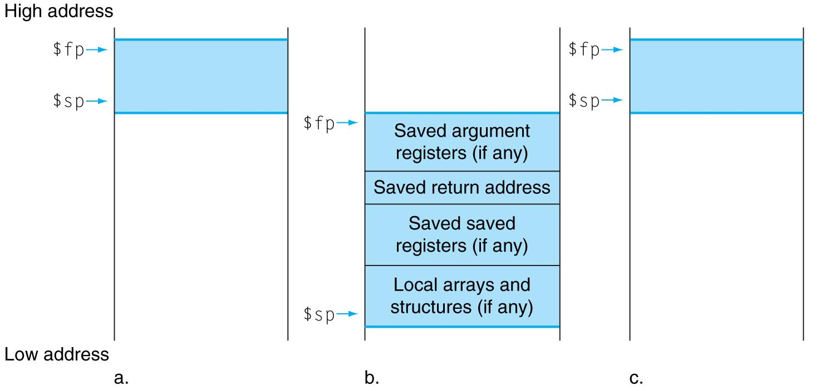
Stack Allocation before, during, and after the procedure call.
before
during
after

Slide 144
Register Conventions (1/4)
CalleR: the calling function
CalleE: the function being called
When callee returns from executing, the caller needs to know which registers may have changed and which are guaranteed to be unchanged.
Register Conventions: A set of generally accepted rules as to which registers will be unchanged after a procedure call (jal) and which may be changed.

Slide 145
Register Conventions (2/4) - saved
$0: No Change. Always 0.
$s0-$s7: Restore if you change. Very important, that’s why they’re called saved registers. If the callee changes these in any way, it must restore the original values before returning.
$sp: Restore if you change. The stack pointer must point to the same place before and after the jal call, or else the caller won’t be able to restore values from the stack.
HINT -- All saved registers start with S!

Slide 146
Register Conventions (3/4) - volatile
$ra: Can Change. The jal call itself will change this register. Caller needs to save on stack if nested call.
$v0-$v1: Can Change. These will contain the new returned values.
$a0-$a3: Can change. These are volatile argument registers. Caller needs to save if they’ll need them after the call.
$t0-$t9: Can change. That’s why they’re called temporary: any procedure may change them at any time. Caller needs to save if they’ll need them afterwards.

Slide 147
Register Conventions (4/4)
What do these conventions mean?
If function R calls function E, then function R must save any temporary registers that it may be using onto the stack before making a jal call.
Function E must save any S (saved) registers it intends to use before garbling up their values
Remember: Caller/callee need to save only temporary/saved registers they are using, not all registers.

Slide 148
Parents leaving for weekend analogy (1/5)
Parents (main) leaving for weekend
They (caller) give keys to the house to kid (callee) with the rules (calling conventions):
You can trash the temporary room(s), like the den and basement (registers) if you want, we don’t care about it
BUT you’d better leave the rooms (registers) that we want to save for the guests untouched. “these rooms better look the same when we return!”

Slide 149
Parents leaving for weekend analogy (2/5)
Kid now “owns” rooms (registers)
Kid wants to use the saved rooms for a wild, wild party (computation)
What does kid (callee) do?
Kid takes what was in these rooms and puts them in the garage (memory)
Kid throws the party, trashes everything (except garage, who goes there?)
Kid restores the rooms the parents wanted saved after the party by replacing the items from the garage (memory) back into those saved rooms

Slide 150
Parents leaving for weekend analogy (3/5)
Same scenario, except before parents return and kid replaces saved rooms…
Kid (callee) has left valuable stuff (data) all over.
Kid’s friend (another callee) wants the house for a party when the kid is away
Kid knows that friend might trash the place destroying valuable stuff!
Kid remembers rule parents taught and now becomes the “heavy” (caller), instructing friend (callee) on good rules (conventions) of house.

Slide 151
Parents leaving for weekend analogy (4/5)
If kid had data in temporary rooms (which were going to be trashed), there are three options:
Move items directly to garage (memory)
Move items to saved rooms whose contents have already been moved to the garage (memory)
Optimize lifestyle (code) so that the amount you’ve got to ship stuff back and forth from garage (memory) is minimized
Otherwise: “Dude, where’s my data?!”

Slide 152
Parents leaving for weekend analogy (5/5)
Friend now “owns” rooms (registers)
Friend wants to use the saved rooms for a wild, wild party (computation)
What does friend (callee) do?
Friend takes what was in these rooms and puts them in the garage (memory)
Friend throws the party, trashes everything (except garage)
Friend restores the rooms the kid wanted saved after the party by replacing the items from the garage (memory) back into those saved rooms

Slide 153
How Computer Communicate with People?
ASCII Code (8 bits per character):
Corresponding MIPS Instruction:
load byte: lb $t0, 0($sp)
save byte: sb $t0, 0($gb)
Unicode (16 bits per character)
Corresponding MIPS Instruction:
load half: lh $t0, 0($sp)
save half: sh $t0, 0($sp)

Slide 154
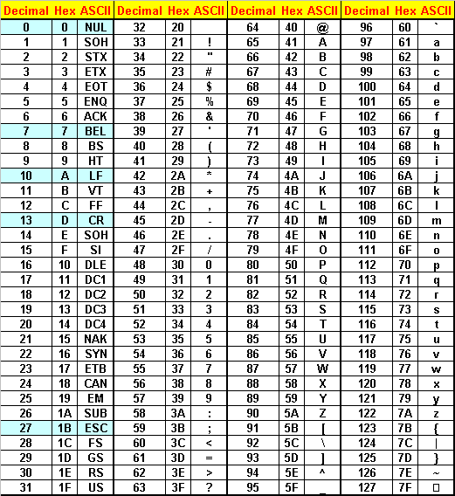
ASCII Table

Slide 155
MIPS Program Example: How to use ASCII code to represent a string?
.text
.globl main
main: li $v0, 4
la $a0, str1
syscall
li $v0, 4
la $a0, str2
syscall
li $v0, 10
syscall # exit
.data
str1:.asciiz "The quick brown fox jumps over the lazy dog\n"
str2:.byte 84, 104, 101, 32, 113, 117, 105, 99
.byte 107, 32, 98, 114, 111, 119, 110, 32
.byte 102, 111, 120, 32, 106, 117, 109, 112
.byte 115, 32, 111, 118, 101, 114, 32, 116
.byte 104, 101, 32, 108, 97, 122, 121, 32
.byte 100, 111, 103, 10, 0

Slide 156
ASCII Poem
^<@<.@*
}"_# |
-@$&/_%
!( @|=>
;`+$?^?
,#"~|)^G
hat less at less point at star
backbrace double base pound space bar
dash at cash and slash base rate
wow open tab at bar is great
semi backquote plus cash huh DEL
comma pound double tilde bar close BEL

Slide 157
Review of MIPS Format
Simple instructions all 32 bits wide
Very structured, no unnecessary baggage
Only three instruction formats
Rely on compiler to achieve performance — what are the compiler's goals?
Help compiler when we can
op rs rt rd shamt funct
R
I
J
op rs rt 16 bit address
op 26 bit address

Slide 158
Addresses in Branches and Jumps
Instructions:
bne $t4,$t5,Label Next instruction is at Label if $t4 ≠ $t5
beq $t4,$t5,Label Next instruction is at Label if $t4 = $t5
j Label Next instruction is at Label
Formats: Address fields are not 32 bits — How do we handle this with load and store instructions?
op rs rt 16 bit address
I
J
op 26 bit address

Slide 159
Branches: PC-Relative Addressing (1/5)
Use I-Format
opcode
rs
rt
immediate
opcode specifies beq v. bne
rs and rt specify registers to compare
What can immediate specify?
immediate is only 16 bits
PC (Program Counter) has byte address of current instruction being executed; 32-bit pointer to memory
So immediate cannot specify entire address to branch to.

Slide 160
Program Counter in a MIPS Computer

Slide 161
Branches: PC-Relative Addressing (2/5)
How do we usually use branches?
Answer: if-else, while, for
Loops are generally small: typically up to 50 instructions
Function calls and unconditional jumps are done using jump instructions (j and jal), not the branches.
Conclusion: may want to branch to anywhere in memory, but a branch often changes PC by a small amount

Slide 162
Branches: PC-Relative Addressing (3/5)
Solution to branches in a 32-bit instruction: PC-Relative Addressing
Let the 16-bit immediate field be a signed two’s complement integer to be added to the PC if we take the branch.
Now we can branch ± 2¹⁵ bytes from the PC, which should be enough to cover almost any loop.

Slide 163
Branches: PC-Relative Addressing (4/5)
Note: Instructions are words, so they’re word aligned (byte address is always a multiple of 4, which means it ends with 00 in binary).
So the number of bytes to add to the PC will always be a multiple of 4.
So specify the immediate in words.
Now, we can branch ± 2¹⁵ words from the PC (or ± 2¹⁷ bytes), so we can handle loops 4 times as large.

Slide 164
Branches: PC-Relative Addressing (5/5)
Branch Calculation:
If we don’t take the branch:
PC = PC + 4
PC+4 = byte address of next instruction
If we do take the branch:
PC = (PC + 4) + (immediate * 4)
Observations
Immediate field specifies the number of words to jump, which is simply the number of instructions to jump.
Immediate field can be positive or negative.
Due to hardware, add immediate to (PC+4), not to PC; will discuss next semester

Slide 165
Summary
We discussed about team project requirements today
Review 210 course syllabus today

